Slide 1

Hiring process analytics
By Bhagyashree parate
Date-2023

Slide 2
Name : Bhagyashree Parate Email-ID : bhagyashreeparate307@gmail.com Data Analytics Trainee Task 4: Hiring Process Analytics , Tech Stack Used : Microsoft Excel
Analysis done on the following points:-
A.Hiring: Process of intaking of people into an organization for different kinds of positions. Your task: How many males and females are Hired ?
B. Average Salary: Adding all the salaries for a select group of employees and then dividing the sum by the number of employees in the group. Your task: What is the average salary offered in this company ?
C. Class Intervals: The class interval is the difference between the upper class limit and the lower class limit. Your task: Draw the class intervals for salary in the company ?
D. Charts and Plots: This is one of the most important part of analysis to visualize the data. Your task: Draw Pie Chart / Bar Graph ( or any other graph ) to show proportion of people working different department ?
E. Charts: Use different charts and graphs to perform the task representing the data. Your task: Represent different post tiers using chart/graph

Slide 3

Agenda
A.Hiring
B. Average Salary
C. Class Intervals
D. Charts and Plots
E. Charts

Slide 4
Description:-
Hiring process is the fundamental and the most important function of a company.
Here, the mncs get to know about the major underlying trends about the hiring process. Trends such as- number of rejections, number of interviews, types of jobs, vacancies etc.
Are important for a company to analyse before hiring freshers or any other individual.
Thus, making an opportunity for a data analyst job here too! Being a data analyst, your job is to go through these trends and draw insights out of it for hiring department to work upon.
• Tool used - Ms-Exce

Slide 5
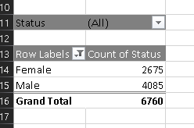
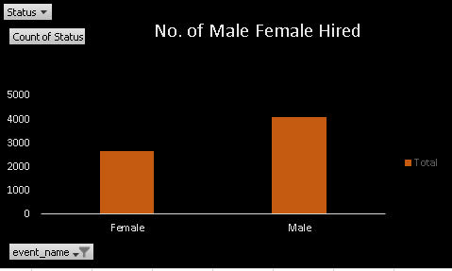
Hiring: Process of intaking of people into an organization for different kinds of positions. Your task: How many males and females are Hired ?

Slide 6
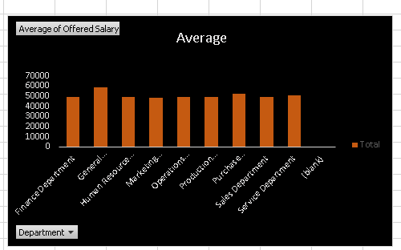
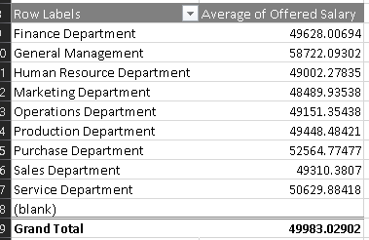
Average Salary : What is the average salary offered in this company ?
ttTo find average salary offered in this company :
Remove the outliers
Then using the formula
=Average(entire_range)
Average = 49983.03223

Slide 7
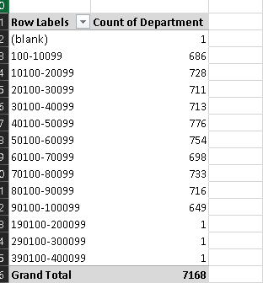
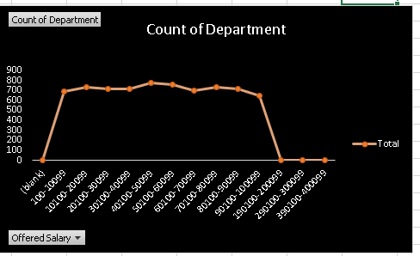
Class Intervals: Draw the class interval for Salary in the Company

Slide 8
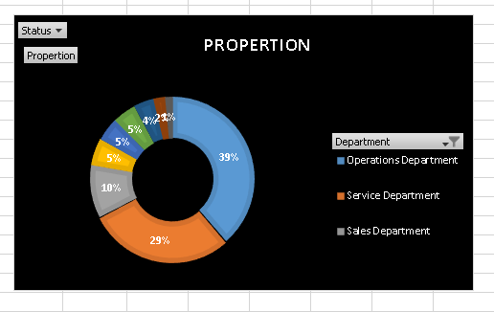
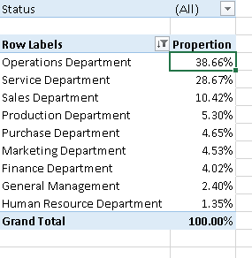
Chart and Plots: Draw pie chart/Bar graph(or nay other graph ) to show proportion people working different deapartment

Slide 9
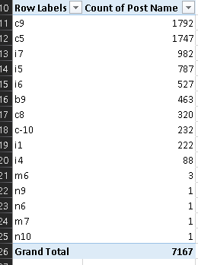
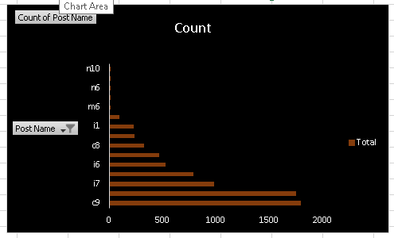
Chats : Represent different post tiers using chart /graph

Slide 10
Excel link :
Hiring process Statistics.xlsx
Google drive link :
https://docs.google.com/spreadsheets/d/1eswo3RC9xldD4crrOMFLwjGmneqiRZio/edit?usp=drive_link&ouid=105378441798796000692&rtpof=true&sd=true

Slide 11

Thank You

